Slide 1
Galaxy Cricket Website
WEB PROGRAMMING

Slide 2

Members
M FUZAIL RAZA (39091)
M WAQAS ZAFAR (38605)
QUDDOS CHAUDARY (36154)

Slide 3
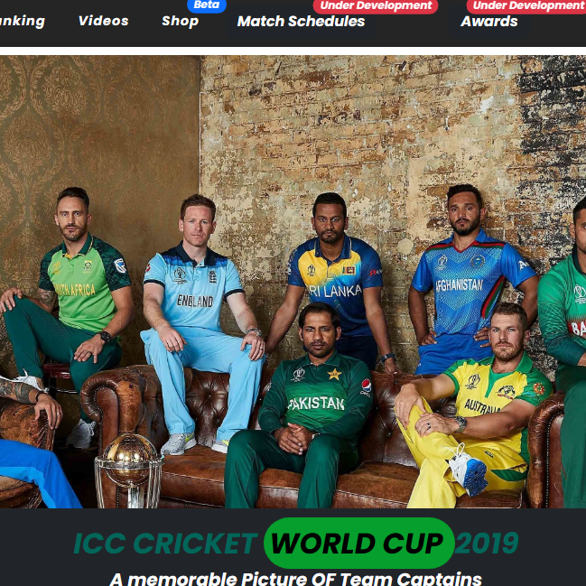
Introduction
Our website, built using HTML, CSS, PHP, and Java Script, is dedicated to providing cricket enthusiasts with a comprehensive and immersive experience. our website offers the latest news, match updates, and interactive features to engage fans from across the globel. Through a seamless combination of these technologies, we have crafted a user-friendly and dynamic platform that captures the essence of cricket

Slide 4
What is the Purpose of this Website?
The purpose of this website project is to establish a strong online presence and create a platform for effective communication, information sharing, and brand building. By developing a well-designed website, we aim to showcase our products/services/cause and engage with our target audience in a meaningful way. The website will serve as a central hub where visitors can easily access relevant information.

Slide 5
Technology Stack
HTML: The foundation of our website, allowing for content structure and organization.
CSS: Adds style and aesthetics, enhancing the visual appeal and user experience.
PHP: Empowers dynamic functionality, enabling interactive features and seamless data processing.
Java: Provides interactivity and responsiveness, ensuring a smooth user interface.

Slide 6
Key Features
Latest News and Updates: Stay informed with the most recent happenings in the cricket world.
Match Information: Get access to live scores, schedules, and in-depth match analysis.
Team Profiles and Statistics: Explore comprehensive profiles and statistical records of your favorite players.
Match Highlights and Videos: Exclusive video highlights of matches, player interviews, and memorable moments.

Slide 7
User Experience (UX)
Our cricket website prioritizes intuitive navigation, responsive design, fast loading speed, engaging visuals, personalization options, clear call-to-actions, accessibility features, streamlined content presentation, and a commitment to continuous improvement.
Real Time Update
Responsive Design

Slide 8
Features
Login
A User Can Login our Website And An Admin who can edit info in website
Team Ranking
Users can explore detailed profiles of their favorite cricket Teams, including their career statistics and information.
NEWS And UPDATES
Multi Media Content
Users can watch match highlights, player interviews, and other cricket-related videos to stay updated and entertained.
Shop
Users can read the latest cricket news, match reports, expert analysis, opinion articles, and feature stories related to the cricket world.
Where User can shop their favorite Teams merchants.

Slide 9
Backend Functionality
PHP-powered Backend
ADD IMAGE HERE
Handles user authentication, data storage, and real-time updates.
Secure Handling: Ensures the confidentiality and integrity of user information.
Database Integration: Efficiently manages and retrieves data, delivering seamless performance.

Slide 10
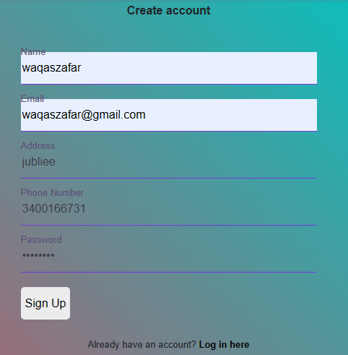
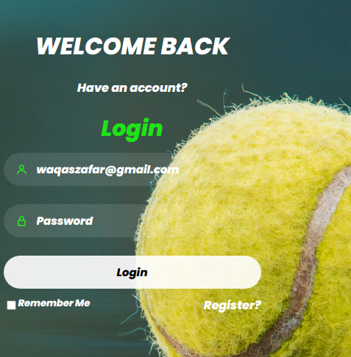
User & Admin Dashboard
User Registration:
Users can create an account by providing their personal information, such as name, email, and password.
User Login:
Registered users can log in to their accounts using their email and password.
Admin Dashboard:
The admin dashboard provides a centralized interface to manage the website's content, users, and other administrative tasks.

Slide 11
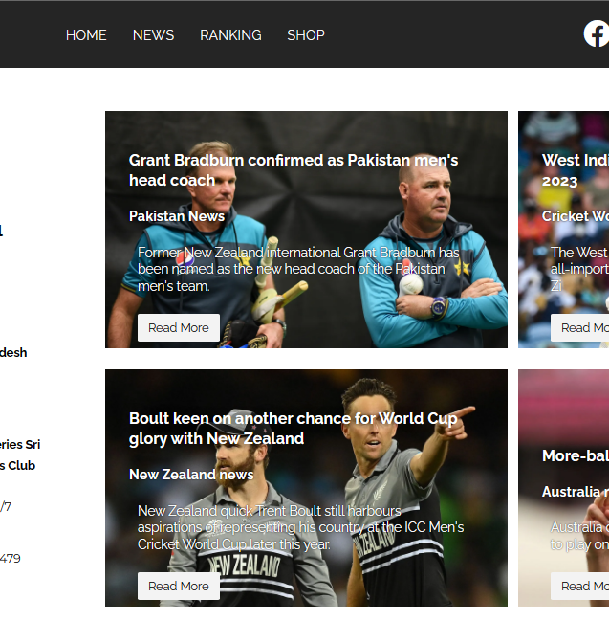

Summary
Our Cricket website offers an immersive and dynamic cricket experience, connecting fans worldwide. With the fusion of HTML, CSS, PHP, and Java, we provide a user-friendly interface and interactive features.

Slide 12
Thank you

